Slide 1
Serverless
Electricity Comes from the Socket and IT Comes from the Cloud

Slide 2
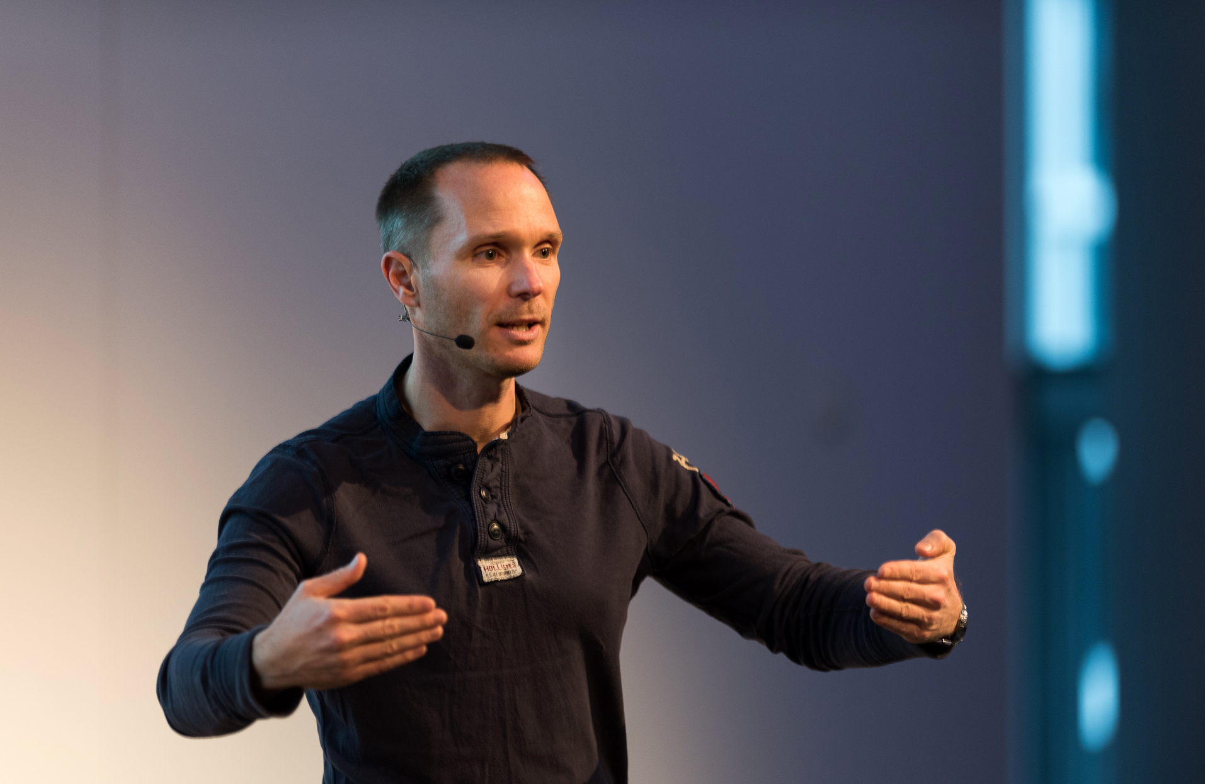
Rainer Stropek
rainer@timecockpit.com @rstropek

Slide 3
Why?

Slide 4
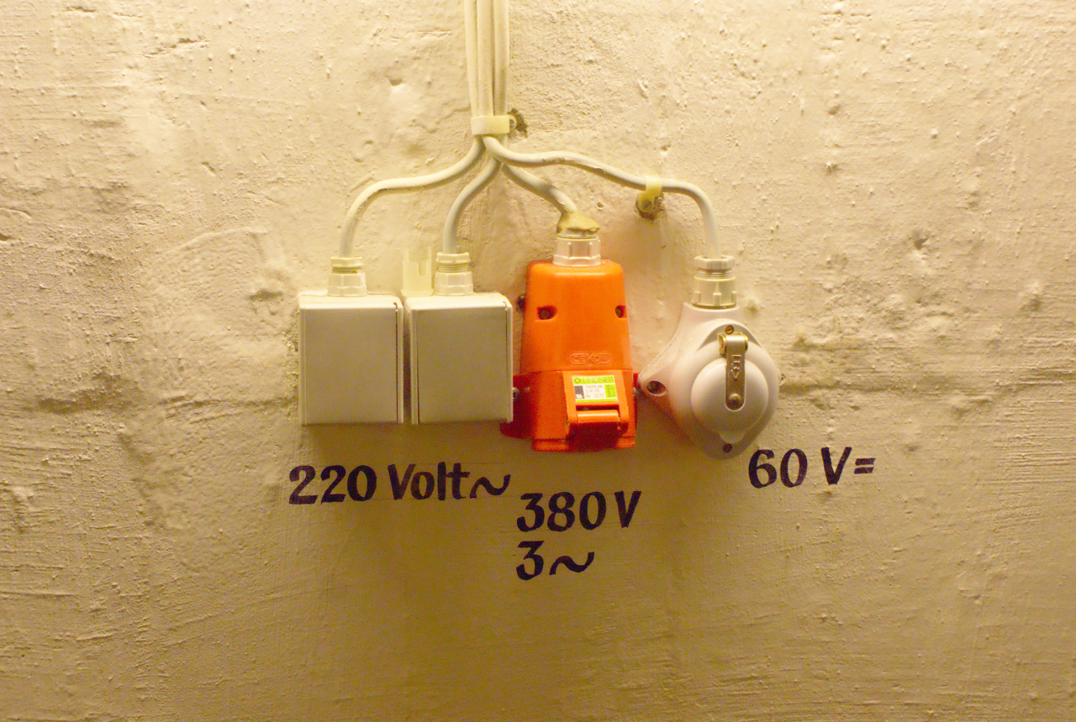
Image Source: https://flic.kr/p/73eSV7

Slide 5
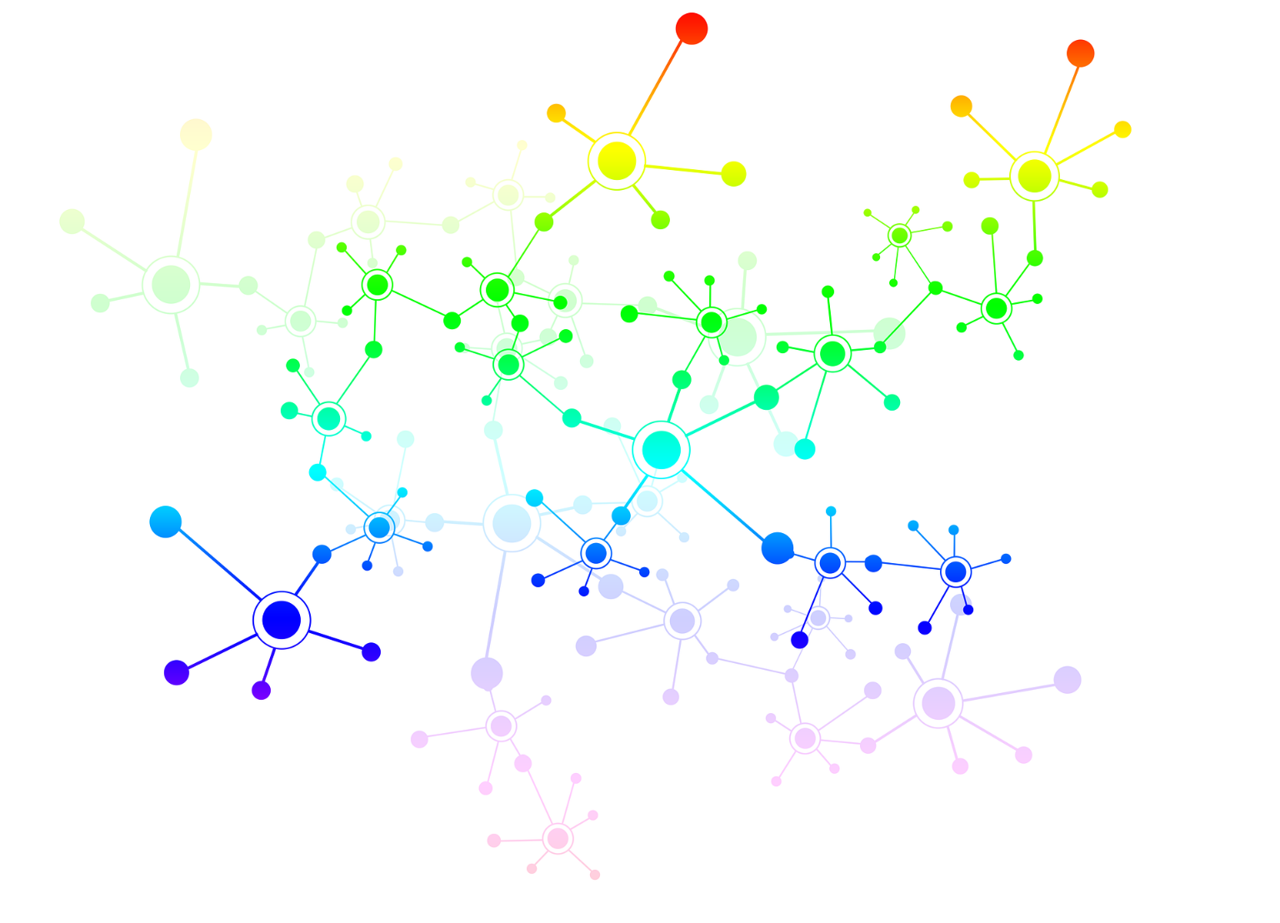
Microservices

Slide 6
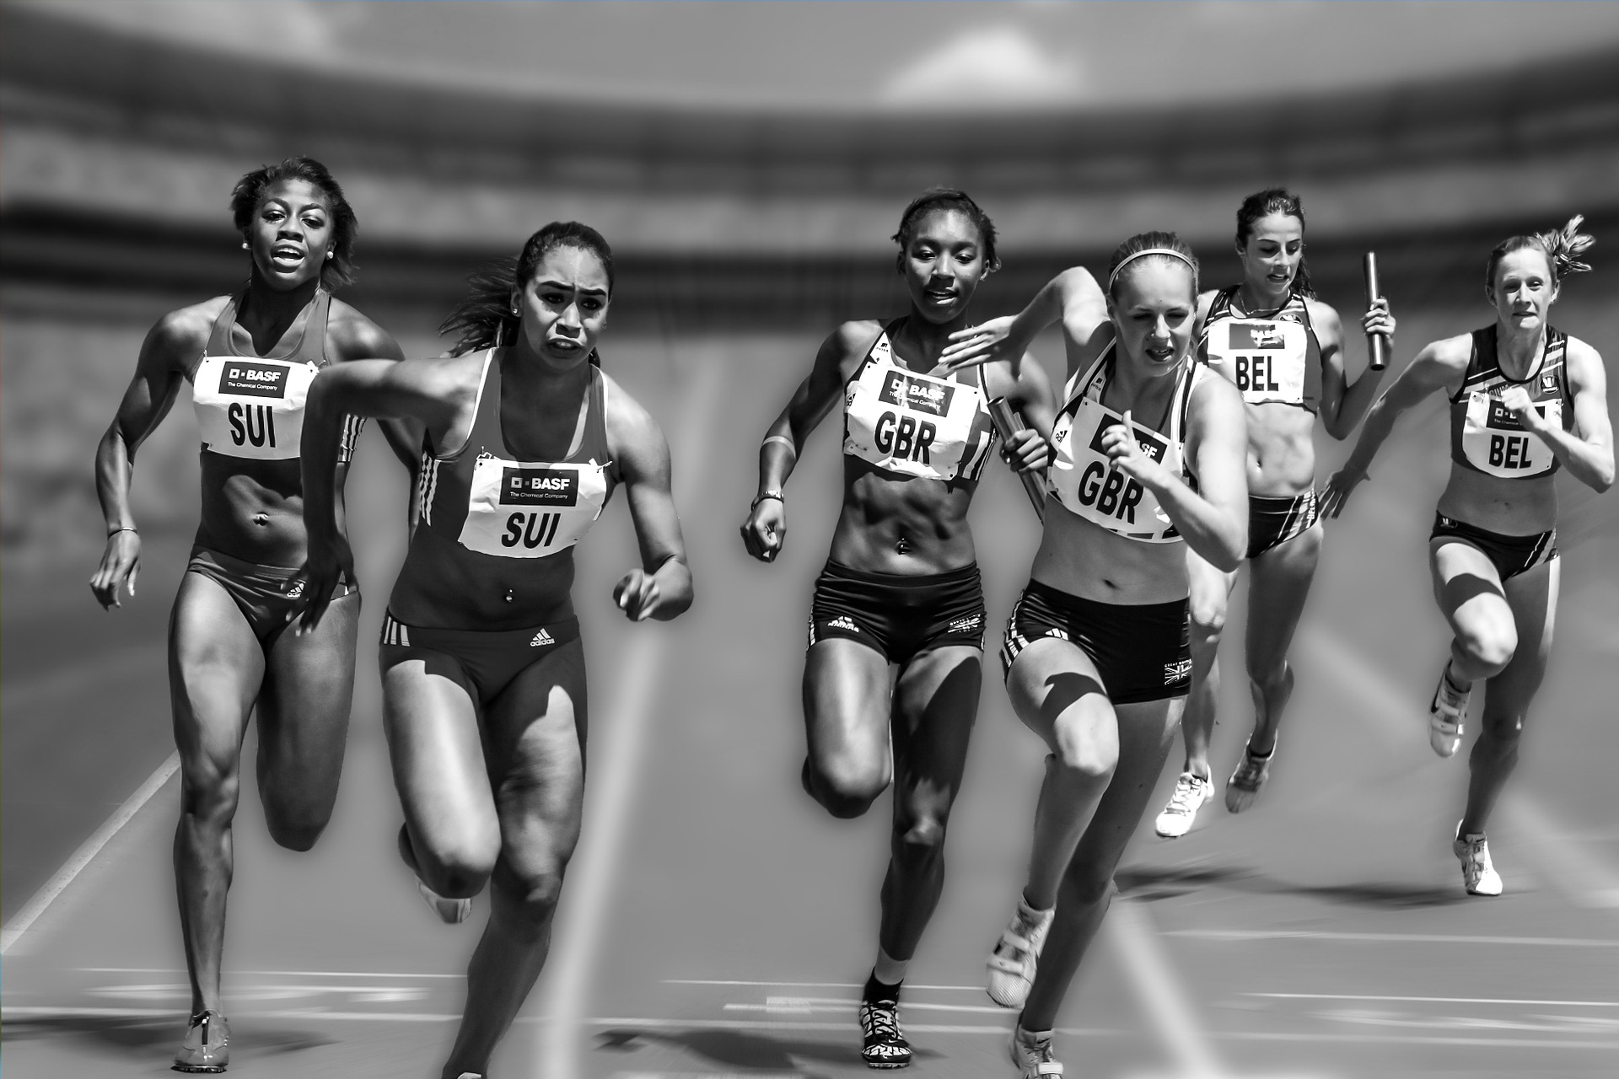
Reactive Programming

Slide 7
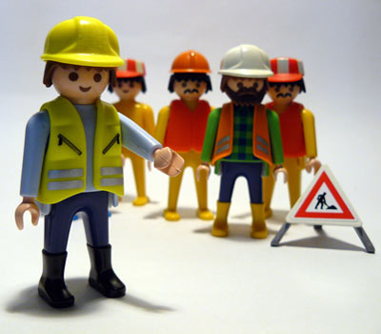
Autonomous Teams
Image Source: https://flic.kr/p/4JGGFW

Slide 8
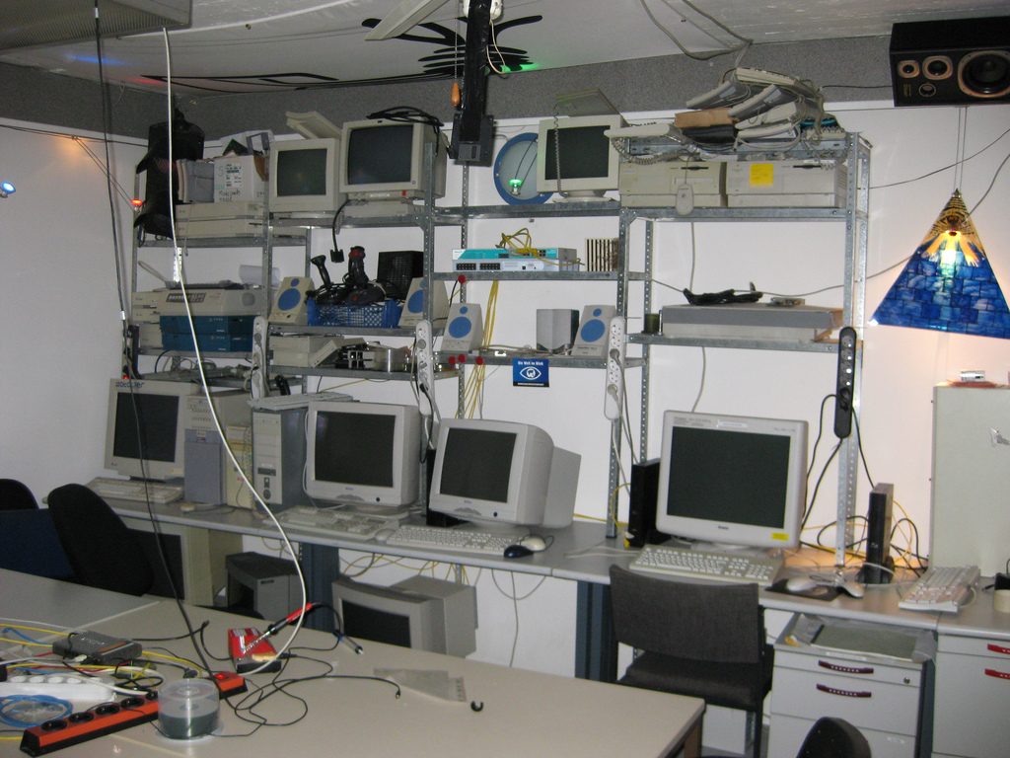
Image Source: https://flic.kr/p/5VB88j

Slide 9
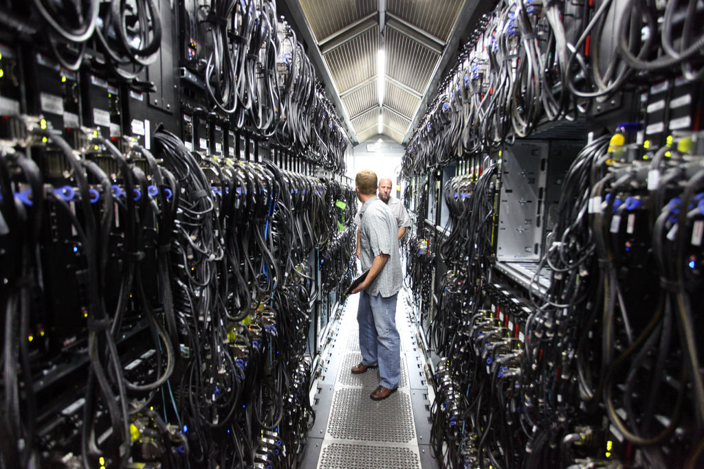
Image Source: https://www.flickr.com/photos/scobleizer/4870003098

Slide 10
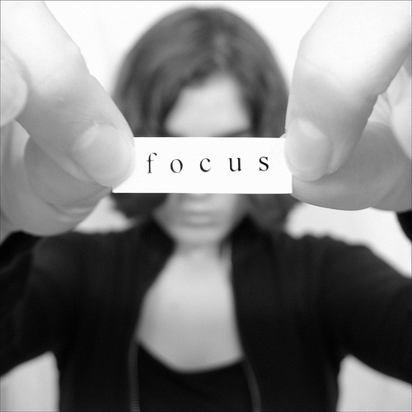
Image Source: https://flic.kr/p/5qtj4r

Slide 11
Why Not?

Slide 12

Trust is Required
Image Source: https://flic.kr/p/9nWs1

Slide 13
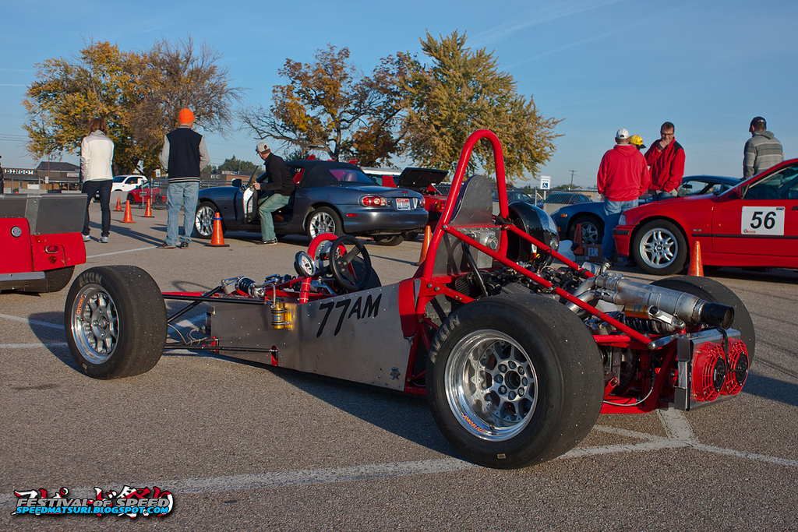
Specific Needs
Image Source: https://flic.kr/p/gWCWqU

Slide 14
Demos

Slide 15
Azure Functions Runtime 2.0
Preview
Not yet ready for production use
Cross-Platform
Based on .NET Core → runs on all platforms including Docker
Extensible
New extension model for bindings and languages
Read more at https://github.com/Azure/azure-functions-host/wiki/Azure-Functions-Runtime-2.0-Overview and https://docs.microsoft.com/en-us/azure/azure-functions/functions-versions

Slide 16
Demo
Azure Portal
Local Functions Runtime
Functions in Docker
Real-World Scenario

Slide 17
Summary

Slide 18
Image Source: https://flic.kr/p/73eSV7

Slide 19
Questions?
Thank you for coming!

